Slide 1
Use Case diagram Concept
Use case is one way of representing system functionality.
Use case refers to
  A system’s behavior (functionality)
  A set of activities that produce some output.
Think in terms of main processes happening in the system.
In the simplest form, use case is a list of functions for a user;
Example →
Use verbs for naming use cases.
9.351 Systems Analysis & Design
Use Case

Slide 2
Use Case Symbols
Use Case
system
Boundary
There are to types of Actor
1: primary actor that receive the service
2: secondary actor that produce or present the service
Actor
The actor may be a someone or company or device
9.351 Systems Analysis & Design
Use Case

Slide 3
Actor Concept
Actor is someone or something interacting with use case.
Similar to the concept of user, although the user can appear
as different actors (e.g., a prof. can be instructor and researcher).
Actor triggers use case.
Actor—Use Case: Actor has responsibility toward the system (inputs), and Actor have expectations from the system (outputs).
Careful: Lines between Actors and Use Cases are NOT data flows!
9.351 Systems Analysis & Design
Use Case

Slide 4
Use Case Diagram
A diagram representing system’s behavior—use cases and actors.
Provides a global look of a system – it’s basic functionality
(use cases) and environment (actors).
Useful for early structuring of requirements; iterative revisions.
May be understood by users on the intuitive level.
9.351 Systems Analysis & Design
Use Case

Slide 5
Relationship in use case
There are many types of relationship:
Relationship between actor and process(use case)
Relationship between actors only
Relationship between use cases (process)
1: relationship between actor and process called (association or connection) the actor make or use the process
9.351 Systems Analysis & Design
Use Case

Slide 6
Relationship in use case
There are many types of relationship:
Relationship between actor and process(use case)
Relationship between actors only
Relationship between use cases (process)
2: Relationship between actors called generalization(inheritance )
student
post graduated student
under graduated student
9.351 Systems Analysis & Design

Slide 7
Relationship in use case
3: Relationship between use cases:
There are many types of relationship between process or use cases
include: this relationship mean that there are tow process one of them rely on the another process
Include relationship –
a standard case linked to an mandatory use case.
Example: to Authorize Car Loan (standard use case), a clerk must run Check Client’s Credit History (include use case).
→ tight coupling
Standard use case can NOT execute without the include case.
9.351 Systems Analysis & Design
Use Case

Slide 8
Relationship in use case
3: Relationship between use cases:
There are many types of relationship between process or use cases
include: this relationship mean that there are tow process one of them rely on the another process
Include relationship –
a standard case linked to an mandatory use case.
Example: to Authorize Car Loan (standard use case), a clerk must run Check Client’s Credit History (include use case).
→ tight coupling
Standard use case can NOT execute without the include case.
9.351 Systems Analysis & Design
Use Case

Slide 9
Relationship in use case
Examples on Include relationship –
Sub use case
Base use case
<<include>>
Login
……………….............
Registration
<<include>>
Check password
Login
……………….............
Delete reply
<<include>>
……………….............
view reply
9.351 Systems Analysis & Design
Use Case

Slide 10
Relationship in use case
3: Relationship between use cases:
There are many types of relationship between process or use cases
2) Extend
Extend relationship –
linking an optional use case to a standard use case.
Standard use case can execute without the extend case.
→ loose coupling
9.351 Systems Analysis & Design
Use Case

Slide 11
Relationship in use case
Examples on Include relationship –
Read document
<<extend>>
……………….............
Add reply
View profile
<<extend>>
……………….............
Edit profile
View course table
<<extend>>
……………….............
Print table
9.351 Systems Analysis & Design
Use Case

Slide 12
Relationship in use case
3: Relationship between use cases:
There are many types of relationship between process or use cases
3) Generalization
Make order
Make online order
Make phone
order
9.351 Systems Analysis & Design
Use Case

Slide 13
ATM system
deposit
Withdraw
Client
Central
bank
Inquiry
Commit transaction
9.351 Systems Analysis & Design
Use Case

Slide 14
Use case example on online
course registration system
online course registration system
Register
.
.
.
.
<<include>>
student
login
View course
Admin
Select course
View table
.
.
.
.
<<extend>>
post
graduated student
under
graduated student
Print table
Add new course info
Update course info
9.351 Systems Analysis & Design
Use Case

Slide 15
Use case scenario
An online shopping portal allows their customers to register to their portal , he can login to the system any time to browse items and add it to the shopping cart . He also can view his shopping cart. The customer can edit the final cart then submit the final payment or logout without buying the items. The site's administrator can add or update different items in the system, manage the registration of new customers and ensure the authorization of already registered customers .
Draw the use case diagram.
9.351 Systems Analysis & Design
Use Case

Slide 16
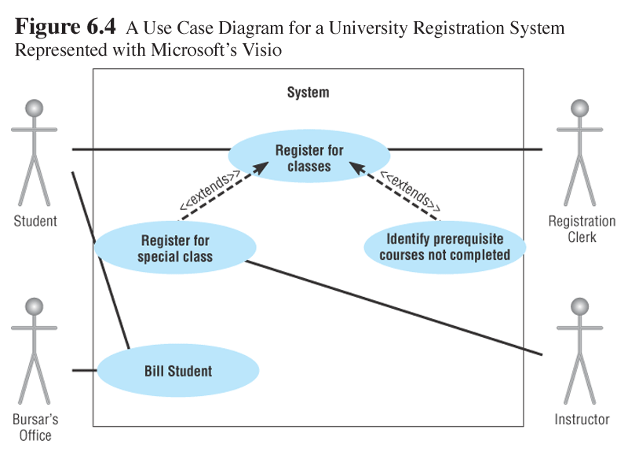
Extend Relationship Between Use Cases
Careful: Arrows between Use Cases are NOT data flows!
9.351 Systems Analysis & Design
Use Case

Slide 17
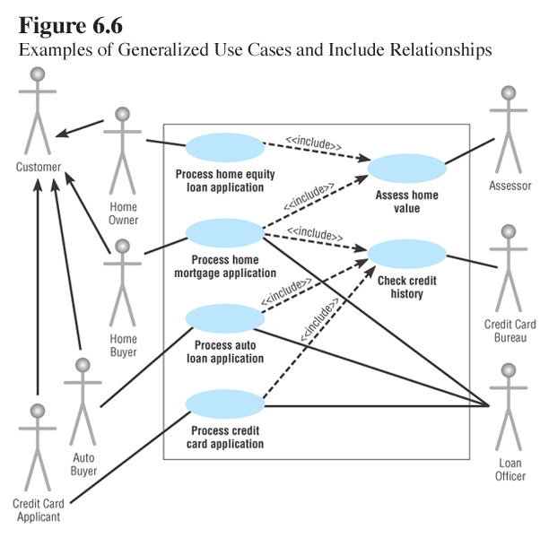
Include Relationship Between Use Cases
Careful: Arrows between Use Cases are NOT data flows!
9.351 Systems Analysis & Design
Use Case

Slide 18
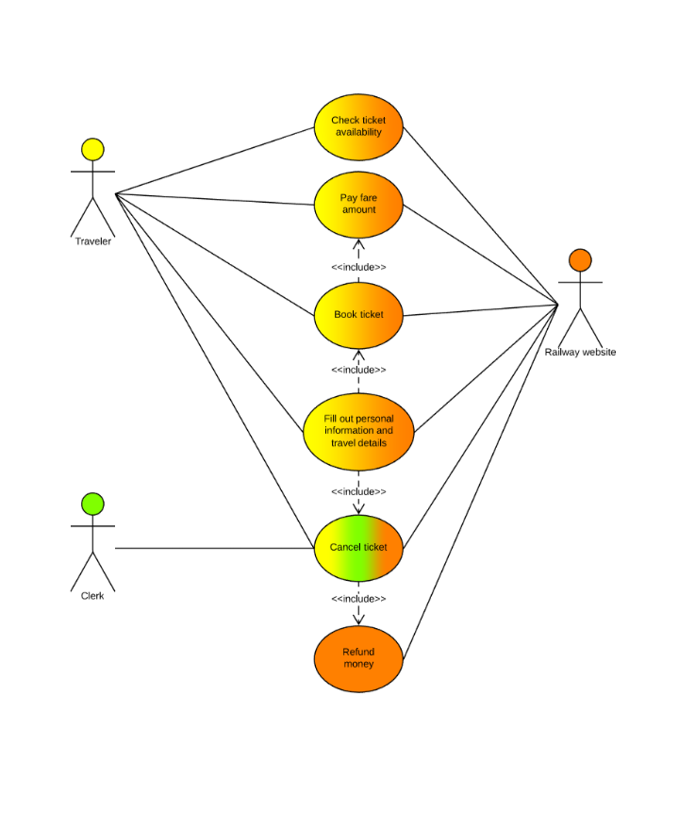
Use case example for online reservation railway ticket
9.351 Systems Analysis & Design
Use Case

Slide 19
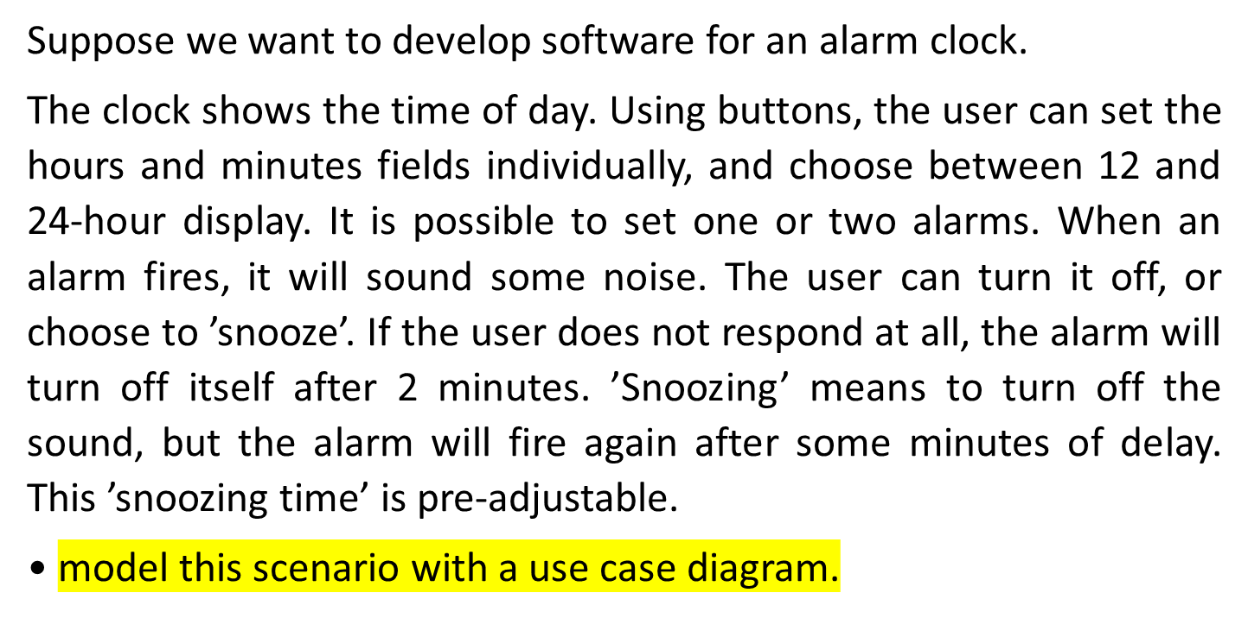
9.351 Systems Analysis & Design
Use Case

Slide 20
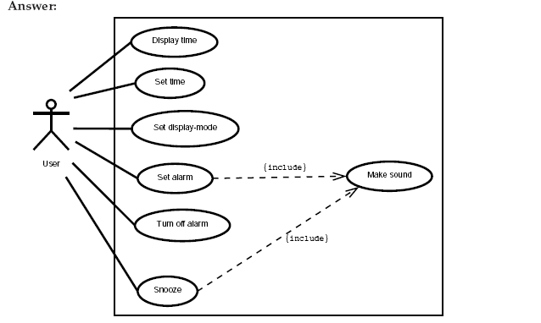
9.351 Systems Analysis & Design
Use Case

Slide 21
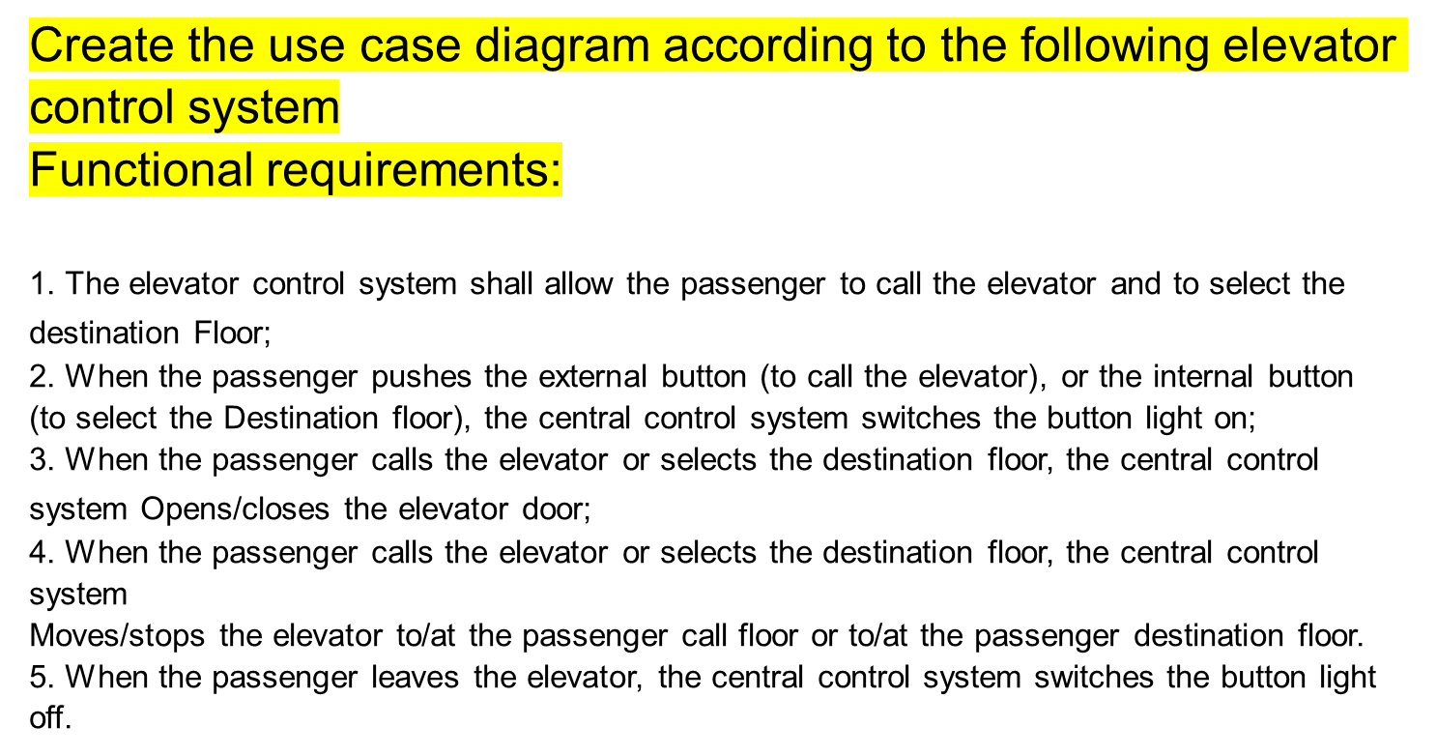
9.351 Systems Analysis & Design
Use Case

Slide 22
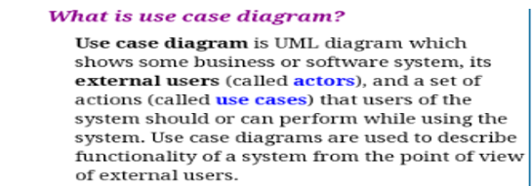
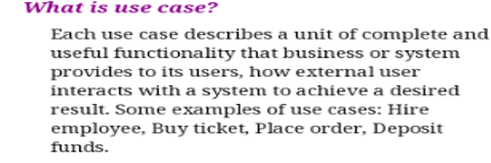
9.351 Systems Analysis & Design
Use Case

Slide 23
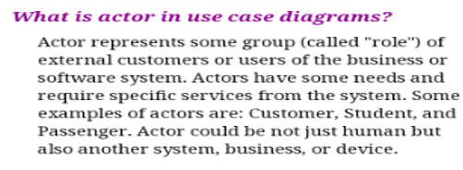
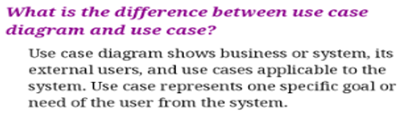
9.351 Systems Analysis & Design
Use Case

